Slide 1
For Fall 2020
https://api.usaspending.gov/
Use the geocaching survey of APIs

Slide 2
Watch https://www.youtube.com/watch?v=V0ucZ4ctof8
Goal: Find the Mario Maker level with the most plays and the most star ratings.
Problem: Collecting the data. Nintendo does not offer it in a giant spreadsheet. You can pull up a query that shows 100 or whatever at a time, but we need 10^6 rows to achieve the goal.
At around 4:35 or so he breaks down the query, explains how someone wrote a script to scrape the website (a polite script too, which is smart - it didn't overwhelm the servers or cause the IP address to get blocked) and then briefly explains some of the other neat things you can find within the data set before diving in to address the goal.

Slide 3
<P>Good afternoon,
<P>In class this week we will be covering the process of getting data. Sometimes data you need for analysis is simply handed to you, but that is rarely the situation. I will provide a review of technical skills and soft (social) skills relevant to getting data.
<P>On the technical side there are a few low-level linux command line tools like <a href="https://en.wikipedia.org/wiki/Wget">wget</a> and <a href="https://en.wikipedia.org/wiki/CURL">curl</a>. The tool we will commonly use in this class is the Python module <a href="http://docs.python-requests.org/en/master/">requests</a> in combination with <a href="https://www.crummy.com/software/BeautifulSoup/">BeautifulSoup</a> for <a href="https://en.wikipedia.org/wiki/HTML">HTML</a>.
<P>Data you seek may be offered through an <a href="https://en.wikipedia.org/wiki/Application_programming_interface">Application programming interface</a> (API). That can be managed using Python.
<P>When data is offline, it's often in electronic documents. Extracting data from documents is a relevant skill we'll discuss.
<P>Lastly, we'll discuss the relevance of <a href="https://en.wikipedia.org/wiki/Synthetic_data">synthetic data</a>.
<P>Kindly,
<P><a href="https://www.linkedin.com/in/john-w-a6579a4/">John</a>

Slide 4
How do I find relevant analysis capabilities in Jupyter notebooks?
Has anyone else ever encountered this task?
Google search for desired capability
Review notebooks from this class (posted to BlackBoard)
Python Standard Library
https://docs.python.org/3/py-modindex.html
https://wiki.python.org/moin/UsefulModules
Python 3 Module of the Week
https://pypi.org/
Notes:
readline or pyreadline module

Slide 5
Once you've found a library, how to learn more: Activity (part 1 of 2)
Open a Jupyter notebook
Type the four commands below into four separate cells
import random
dir(random)
help(random)
random?

Slide 6
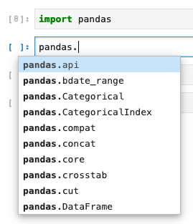
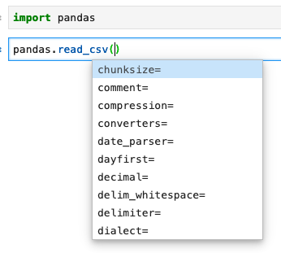
Activity (2 of 2): Tab completion in Jupyter notebooks
Type the commands below in a code cell

Slide 7
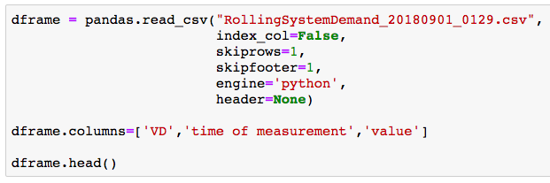
Complex commands do not just appear; I iteratively discover commands
I don't memorize these commands. I build them iteratively.
The result is concise; it hides hours of detective work.

Slide 8

What's going on

Slide 9
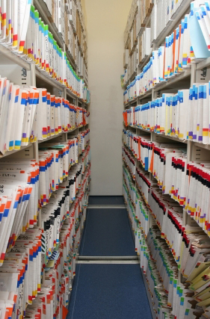
Getting data
Fall 2020
These notes are CC BY 4.0
Notes:
https://en.wikipedia.org/wiki/Web_scraping
https://en.wikipedia.org/wiki/Data_scraping
https://benbernardblog.com/web-scraping-and-crawling-are-perfectly-legal-right/
https://www.forbes.com/sites/ericgoldman/2015/03/24/qvc-cant-stop-web-scraping/

Slide 10

Course schedule and outline (scope)
: time series analysis
: Scaling up, Estimation
: Elasticity, Cost/benefit
: Property graphs
: Ethics and Legality
1: Overview of Data Science
2: Python in Jupyter
3: Getting data
4: Data cleanup
5: Automation; Reports
6: Project 1 presentations
7: Math

Slide 11
Outcomes for this evening By the end of today's class, you should be able to do the following:
Describe how your computer accesses content on the Internet
Scrape content from websites using Python libraries
Explain the moral and ethical issues of scraping
Demonstrate use of APIs
Extract content from documents (PDF, DOCX, RTF) and from webpages (HTML using BeautifulSoup)

Slide 12
I use free software and free data for this class
There's lots of commercial software available
Financially, I don't want to pay for software or data
Logically, I believe in being software/platform agnostic
I want to enable reproducibility for other people
Notes:
https://www.gnu.org/philosophy/shouldbefree.en.html

Slide 13

Science
Science
Homework review
Getting Data using Computers
Scraping Data
APIs
Activity: Negotiating for Data
Get Data from Documents
Fake Data
Homework

Slide 14
Steps commonly observed in practice:
data gathering
cleaning data
data analysis
data visualization
That doesn't mean you are applying a scientific process
Getting data and using Python does not make you a Data Scientist
"Data Science" without Science

Slide 15
What is Science?
Science is a systematic enterprise that builds and organizes knowledge in the form of testable explanations and predictions about the universe.
https://en.wikipedia.org/wiki/Science
Notes:
https://web.stanford.edu/class/stats101/intro/intro-lecture01.pdf

Slide 16

What is your perception of the process of Science?
Activity: Share your thoughts in the Discussion board

Slide 17
How to Science
Observation = Data
Curiosity about relations
Model = a story using math to describe relations in the data
Prediction = based on assumptions
Test = (in)validate assumptions
Notes:
https://www.youtube.com/watch?v=j12BBcKSgEQ

Slide 18
Make a claim, Test the claim
A claim should be falsifiable. The test should be statistically meaningful.
In practice, strictness depends on intended outcome --
Good enough to make money:
Altering what color the button on your ecommerce website is to maximize sales
Recommending a movie to viewers
Critical to safety or health of humans:
Determining which dosage of a drug is efficacious for medical treatments
Guidance for an autonomous vehicle
Notes:
Talking:
This slide is a comment on the level of rigor relevant in different applications of data science. In contrast to slide 10, not everyone has the objective of advancing the state of human knowledge; some just want to make money.
If your algorithm generates a result that is statistically insignificant but still makes money, you can claim success. There are domains where a more rigorous basis is needed, eg when human safety is a factor.

Slide 19
Hard task in Science: Reproducibility
Someone else, following only your documentation, should be able to get an outcome that validates your claim.
From authors view: investment without immediate benefit.
Content creator generates technical debt
Who is impacted by reproducibility: your future self; others.
Notes:
https://en.wikipedia.org/wiki/Reproducibility
https://en.wikipedia.org/wiki/Replication_crisis
Talking:
I didn't specify that reproducibility is present in the previous slide on the process of science. Data scientists (especially doing EDA) don't focus on reproducibility due to the incentives of moving quickly to make money.

Slide 20
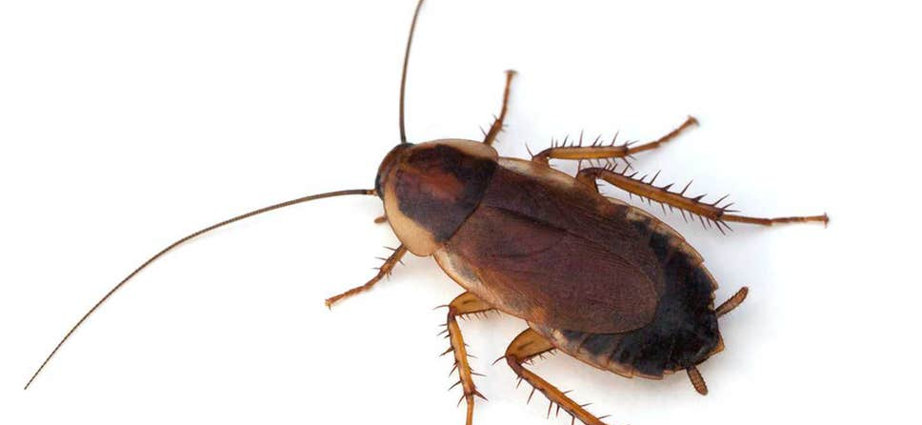

Example reasons why reproducibility fails
The outcome was specific to the data used
Assumptions were wrong
Documentation provided is insufficient to enable reproducibility
Software implementation has a bug
Notes:
https://en.wikipedia.org/wiki/Reproducibility
https://en.wikipedia.org/wiki/Replication_crisis
http://www.ruf.rice.edu/~bioslabs/tools/notebook/notebook.html

Slide 21
Homework review
Science
Homework review
Getting Data using Computers
Scraping Data
APIs
Activity: Negotiating for Data
Get Data from Documents
Fake Data
Homework

Slide 22
Homework review
Programming Decomposition of Course Grade
Shuffle
CSV in Pandas
Word count and character count

Slide 23
Getting Data using Computers
Science
Homework review
Getting Data using Computers
Scraping Data
APIs
Activity: Negotiating for Data
Get Data from Documents
Fake Data
Homework

Slide 24
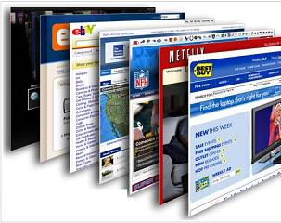
Online digital content
Normally presented via a GUI (web browser) for human interaction
Notes:
http://techviewes.blogspot.com/2014/08/capture-screenshots-of-long-webpages.html

Slide 25
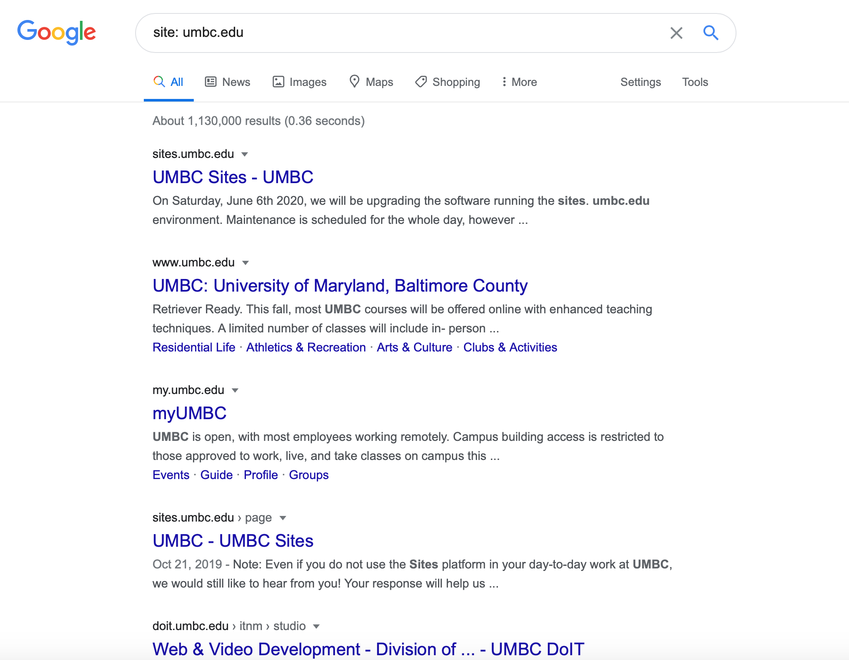
I want all the data
Google has indexed
trillions of web pages

Slide 26
Example of data sources
A well-rounded data scientist can extract data from any source
Web GUI – unstructured text, electronic format
Databases (SQL, HBase, Accumulo)
Semi-structured text and mixed media, i.e. Word/PDF documents
API (REST, SOAP)
Electronic documents (Word, Powerpoint, Excel)
Books, papers (hard copy) – unstructured text

Slide 27

How to computer: Internet version
Type in web address
Get Content
If that's all you know, then that's all you can do
Notes:
http://kenfager.com/wordpress/?p=2413
Joke: "of horse I can internet"

Slide 28
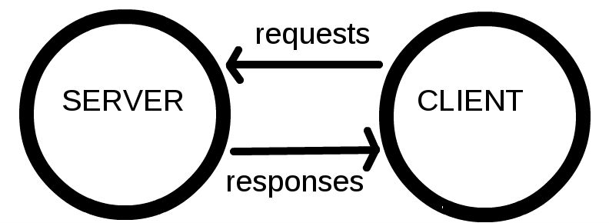
New Knowledge means New Vocabulary
In your role as a data scientist, understanding this jargon enables discussion of processes relevant to getting data
Notes:
https://developer.mozilla.org/en-US/docs/Learn/Getting_started_with_the_web/How_the_Web_works

Slide 29
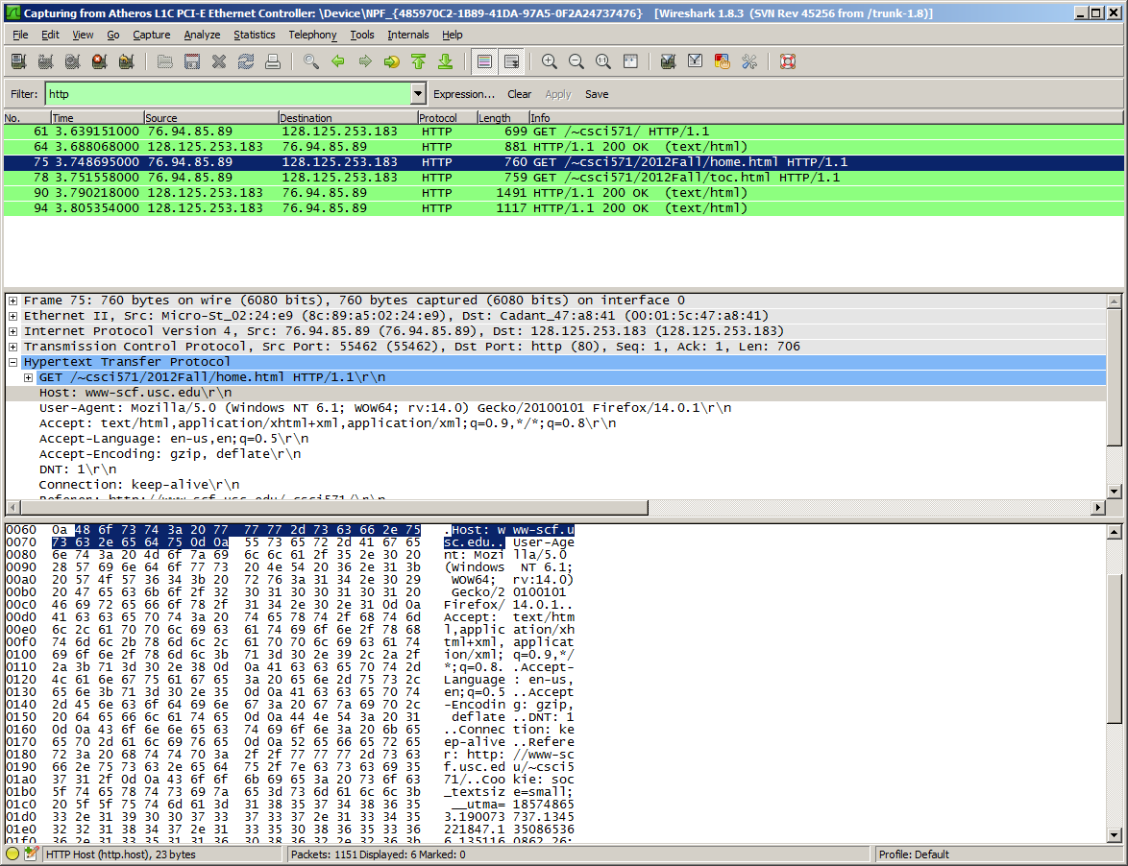
Packets contain information
Text
HTML: Hyper Text Markup Language
CSS: Cascading Style Sheets
JavaScript
Other media, i.e. sound, video, images
As a data scientist, this is likely a layer of knowledge deeper than most of you will care about
There's lots of data available to be analyzed in cybersecurity
Notes:
https://motherboard.vice.com/en_us/article/jpgmxp/how-to-go-from-0-to-sniffing-packets-in-10-minutes

Slide 30
Process of getting a webpage
Client computer is connected to Internet and has an address
Person on client computer enters URL in web browser
URL is resolved to address of server
Using HTTP, browser sends a GET request to the server asking for the file https://mydomain.com/web-server.htm
Server sends content to client computer
Client computer renders the HTML content as a web page
Disclaimer: not describing ports, IP, DNS, TCP/IP, cookies, certs
Why this matters to you, the data scientist: when the process fails, your ability to troubleshoot depends on understanding the process
Notes:
https://medium.com/@maneesha.wijesinghe1/what-happens-when-you-type-an-url-in-the-browser-and-press-enter-bb0aa2449c1a
https://web.stanford.edu/class/msande91si/www-spr04/readings/week1/InternetWhitepaper.htm

Slide 31
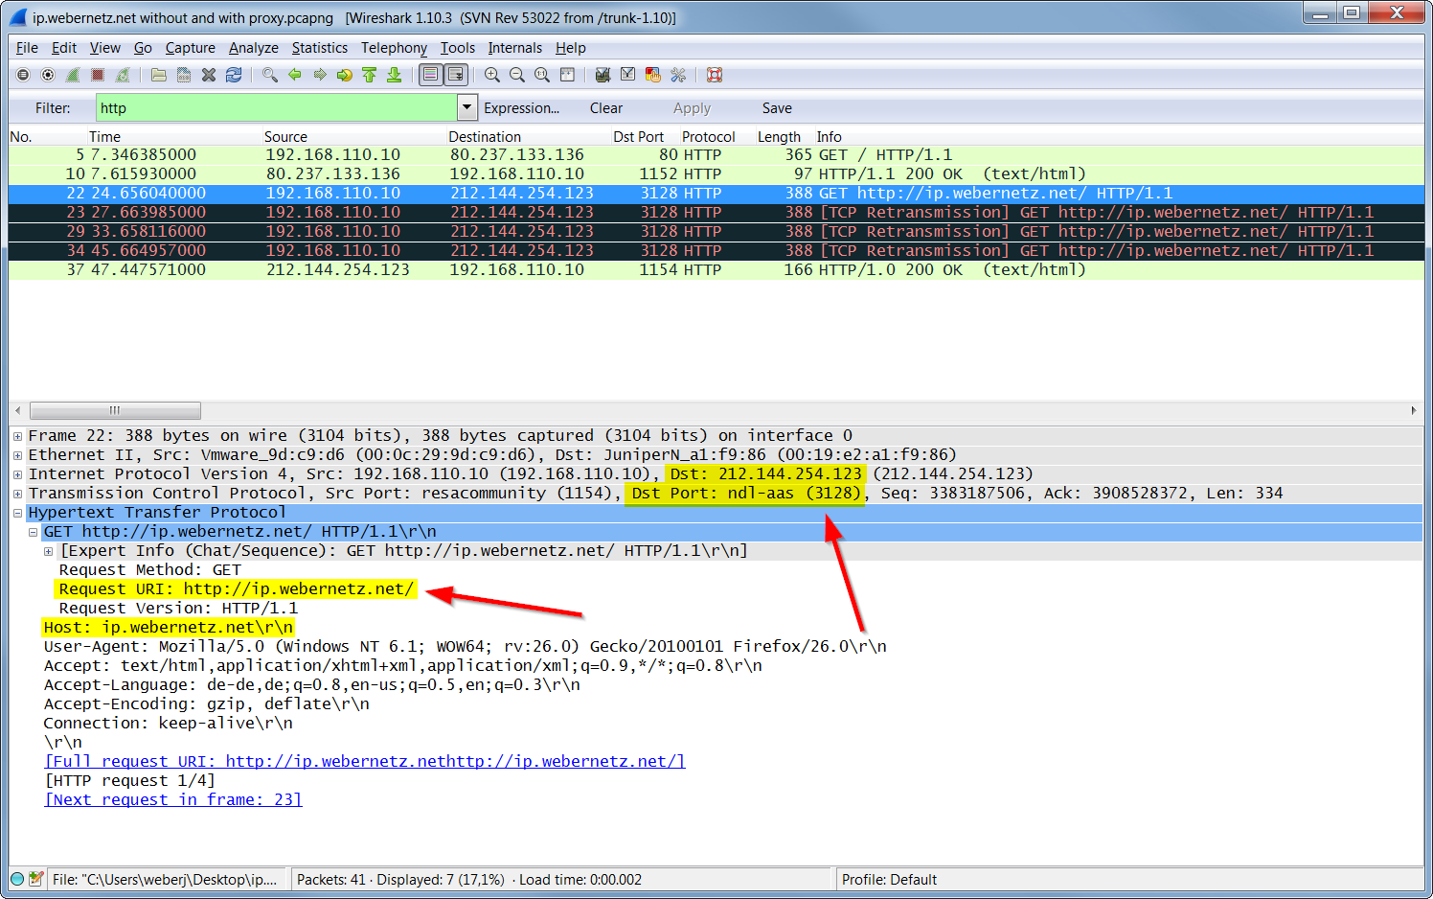
Motivation: show you that the process of data gathering is composed of understandable steps
Notes:
https://gitlearning.wordpress.com/2017/01/23/wireshark-lab-http/

Slide 32
Using computers to do boring repetitive work
There are many software tools to automate getting data on the web
curl
wget
Requests (Python)
Scrapy (Python)
We will focus on text content

Slide 33
Scraping Data
Science
Homework review
Getting Data using Computers
Scraping Data
APIs
Activity: Negotiating for Data
Get Data from Documents
Fake Data
Homework

Slide 34

"I didn't know that was illegal"
Ignorance of the law is no defense to criminal charges
Mistakes happen, but that doesn't mean you're not liable
I am not a lawyer
This is not legal advice
Notes:
https://www.nolo.com/legal-encyclopedia/can-i-convicted-crime-i-didn-t-realize-i-illegal.html
https://www.nolo.com/legal-encyclopedia/is-mistake-fact-defense-criminal-charges.html

Slide 35
Legality of Content Scraping
Web Scraping = automated collection of content
Few sites make explicit statements about scraping
Example: https://www.50states.com/terms.htm
Web Crawlers
consume server resources (CPU, memory, power)
consume bandwidth
Access parts of sites not commonly accessed by humans
Notes:
https://benbernardblog.com/web-scraping-and-crawling-are-perfectly-legal-right/
https://www.forbes.com/sites/ericgoldman/2015/03/24/qvc-cant-stop-web-scraping/

Slide 36
Instructions for crawlers: Robots.txt
http://www.robotstxt.org/robotstxt.html
Based on your user agent string:
https://www.whatismybrowser.com/detect/what-is-my-user-agent
Example robots.txt files:
https://cs.stanford.edu/robots.txt
https://slashdot.org/robots.txt

Slide 37
Activity: discuss ethics of scraping content
In groups of three, consider your legal risks and moral issues:
At what scale does scraping become an issue?
Just a few pages of content versus an entire domain
Does your stance change based on who you are getting content from?
Small business versus large corporation
Does your position change based on the purpose of scraping?
For research versus for commercial interest

Slide 38
Activity: Gather - ethics of scraping content
On the whiteboard, gather comments on
At what scale does scraping become an issue?
Just a few pages of content versus an entire domain
Does your stance change based on who you are getting content from?
Small business versus large corporation
Does your position change based on the purpose of scraping?
For research versus for commercial interest

Slide 39

Example of Data Scraping
In 2016, "a group of Danish researchers publicly released a dataset of nearly 70,000 users of the online dating site OkCupid, including usernames, age, gender, location, what kind of relationship (or sex) they’re interested in, personality traits, and answers to thousands of profiling questions used by the site."
https://www.wired.com/2016/05/okcupid-study-reveals-perils-big-data-science/

Slide 40
Tools for getting content: wget (22 years old!)
Normally a command in linux
supports HTTP, HTTPS and FTP
able to recover from a prematurely broken transfer
Examples:
wget www.fogcam.org
wget -m –-limit-rate=200k http://mysite.com
-m=mirror; rate limit to 200 kB/sec
Can follow links in content
Also available in Python - https://pypi.org/project/wget/
Notes:
https://daniel.haxx.se/docs/curl-vs-wget.html

Slide 41
curl
Normally a command in linux
Supports FTP, FTPS, Gopher, HTTP, HTTPS, SCP, SFTP, TFTP, TELNET, DICT, LDAP, LDAPS, FILE, POP3, IMAP, SMB/CIFS, SMTP, RTMP and RTSP
Example:
curl www.fogcam.org
Also available in Python as "import pycurl"
https://curl.trillworks.com/
http://pycurl.io/docs/latest/index.html
Notes:
https://daniel.haxx.se/docs/curl-vs-wget.html

Slide 42
Python: Requests
Send HTTP using Python, get webpage back
getting_data/get_1_requests.ipynb

Slide 43
Python: Scrapy
Framework for creating a web crawler
https://doc.scrapy.org/en/latest/intro/tutorial.html
conda install -c conda-forge scrapy
A site intended for exploration: http://toscrape.com/
http://quotes.toscrape.com/
http://books.toscrape.com/

Slide 44
Having data for a browser is insufficient
Scraping tools get data from the Internet
Data for web browsers is not suitable for analysis
Activity: view source of https://www.umbc.edu/
In Chrome, View > Developer > View Source
In Firefox, Tools > Web Developer > Page Source

Slide 45
Parsing HTML using beautifulsoup
getting_data/get_2_beautifulsoup.ipynb
getting_data/get_3_table_requests_bs4_pandas.ipynb
getting_data/get_4_requests_bs4_blocked_by_server.ipynb
getting_data/get_5_requests_bs4_table_violates_robots.ipynb

Slide 46
Summary of Tools
Getting data:
wget, curl
Requests, scrapy
Analyzing HTML:
BeautifulSoup
For Data 601, requests + BeautifulSoup is typically relevant

Slide 47
Application Programming Interfaces
Science
Homework review
Getting Data using Computers
Scraping Data
APIs
Activity: Negotiating for Data
Get Data from Documents
Fake Data
Homework

Slide 48
Scraping data isn't the only path
https://www.ssa.gov/oact/babynames/
Year and Popularity scale for a List of the Most Popular Names
Can we scrape the data?
https://www.ssa.gov/robots.txt
Do policies allow scraping?
https://www.ssa.gov/agency/websitepolicies.html

Slide 49
Sometimes data is made available for download
https://www.google.com/search?q=site%3Assa.gov+download+baby+names
https://www.google.com/search?q=site%3Assa.gov+api
In this case, we find the data is available for direct download:
https://www.ssa.gov/oact/babynames/limits.html
https://catalog.data.gov/dataset?tags=baby-names
https://www.ssa.gov/open/data/
https://www.ssa.gov/data/

Slide 50
Example of a simple API
http://swoogle.umbc.edu/SimService/
http://swoogle.umbc.edu/SimService/api.html
getting_data/get_6_requests_use_simple_API.ipynb
Another UMBC API for events:
curl https://my3.my.umbc.edu/api/v0/events.xml?mode=upcoming
Documented here: https://my3.my.umbc.edu/groups/myumbc/files/3247

Slide 51
Constrain access using API keys
https://sis.jhu.edu/api as an alternative to https://sis.jhu.edu/classes/
getting_data/get_7_requests_use_API_with_key.ipynb

Slide 52
Activity: Negotiating for Data
Science
Homework review
Getting Data using Computers
Scraping Data
APIs
Activity: Negotiating for Data
Get Data from Documents
Fake Data
Homework

Slide 53
Working with data owners
Not all data is directly accessible
As a data scientist in a large organization, your team isn't the profit generator
The data scientist also isn't the knowledge owner
You have to convince people with data that you can help them
You have to convey ability to assist and ability to communicate at their level in their jargon

Slide 54
Role play activity: negotiating to find fear/hope
Part 1
Data owners move to one side of room,
data requesters move to other side
Review your prompts
Each group collaborates on strategy

Slide 55
Role play activity: negotiating to find fear/hope
Part 2
Find a partner from the other team that you haven't collaborated with recently
Engage your partner

Slide 56
(Activity) Negotiation with partner
Requester asks Owner, "do you have this data set?"
Owner says, "Yes"
Requester: "I want a copy of the data you have."
Owner: use an excuse
Requester: persist
Owner: indicate fear
Requester: how will you address the owner's fear?

Slide 57
Get data from Documents
Science
Homework review
Getting Data using Computers
Scraping Data
APIs
Activity: Negotiating for Data
Get Data from Documents
Fake Data
Homework

Slide 58
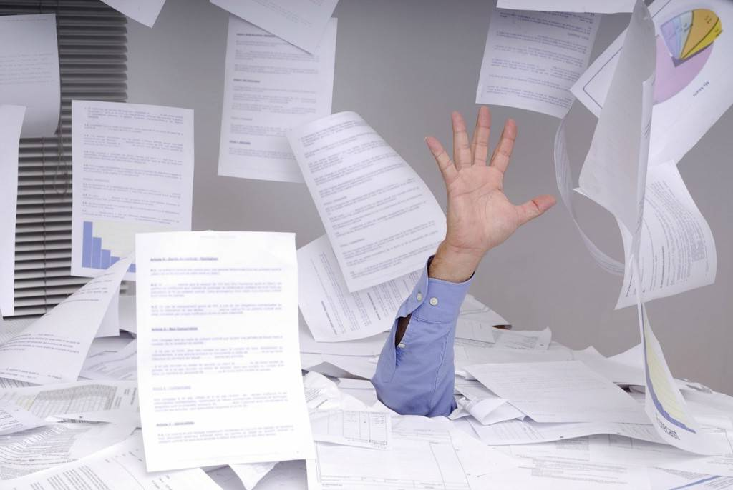
Getting data from (electronic) documents
Not all data is on the Internet
Internal business records
Reports
Essays submitted by students of Data 601 section 4
getting_data/text_1_extract_text_from_docx.ipynb
--> If you can losslessly convert your document to HTML, do that

Slide 59
Activity: pair programming
Instructor creates random pairs of students
Students: find your partner. If your partner is not present, alert the instructor

Slide 60
Activity: pair programming
Download the text documents from
Blackboard > Course materials > week 3 > week 1 essay
With your partner, create a Jupyter notebook that reads all the .txt files and stores the content into a dictionary.
The key is the file name, the value is the text file content
When you are done, split up and join another team

Slide 61
Get data from Documents
Science
Homework review
Getting Data using Computers
Scraping Data
APIs
Activity: Negotiating for Data
Get Data from Documents
Fake Data
Homework

Slide 62

When you don't have the data you need
Fake (synthetic) data
What variables would you need in your model?
What is the distribution of each variable?
Expected frequency of measurements?
Expected number of instances?
Expected data format (JSON, XML, CSV, HTML, DOCX)
Expected data type (date strings, text, numbers)
https://www.generatedata.com/ https://www.mockaroo.com/

Slide 63
Benefits of using fake data
No sensitive or confidential information; privacy not at risk
Enables you to write analysis before you have the data
Play with visualizations
Generate report layout
Negotiate with stakeholders so they have something to point at

Slide 64
How to create fake data
Consider the characteristics of the data
Name
Phone number
address
Create data that has those characteristics
Create the data structure you want to work with
List, table
Streaming versus static
import random
random.choice(['bob','sue','jim'])

Slide 65
Homework
Science
Homework review
Getting Data using Computers
Scraping Data
APIs
Activity: Negotiating for Data
Get Data from Documents
Fake Data
Homework

Slide 66
Homework Assignment: Generate fake data
Write a Python notebook that generates a file containing the following data:
Email addresses. Must have @
Phone numbers
Home Address
Person's name
Year born. Use realistic values.
User of your notebook should be able to specify how many entities are to be generated.
Notebook must be able to generate at least 100 unique rows (assuming users specifies >=100 rows)
Order of columns in CSV is not relevant.
Number of kids. Use realistic values.
Categorical variable: rent or own?
Annual income. Optional challenge: Use a non-uniform distribution
Number of speeding tickets in past year.
Optional challenge: Use a non-uniform distribution
Notes:
A list of falsehoods:
https://github.com/kdeldycke/awesome-falsehood
Removed because I haven't taught Pandas yet:
* Generate data in 2 of the following 3 formats: XML, CSV, or JSON. Your choice!
* The same entities should appear in both file formats

Slide 67
Breakdown each Homework assignment, Part 1 of 2
Draw or write down what you're starting with
Draw or write down what the outcome should look like

Slide 68
Breakdown each Homework assignment, Part 1 of 2
Draw or write down what you're starting with
Draw or write down what the outcome should look like
def fake_data(file_name,number_of_entities):
return
Write on paper what will the CSV will look like

Slide 69
For the second assignment,
Design your approach to solving problem
On a piece of paper, write down actions you'll need to take
Determine the dependencies among the actions you need to take
In what order should the steps be?

Slide 70
Design advice for homework assignment
How may rows the output CSV should be? I don't specify how many rows should be generated. That's because I am interested in the code you write and the .ipynb you submit. I am not seeking the output file for submission. The user of your code should be able to specify how many entries of fake data get generated.
Decompose this complex assignment into multiple functions. For example, create a function that generates a random phone number. Then create a function that generates a random name. Create functions for each desired field. Then, when you want to generated an entry, you can call each of the relevant functions.
I did not specify how realistic the fake data should be. For example, the name "Ben" is very realistic, while the string "mixqnafasf" as a name might be considered less realistic. When I'm grading your assignment, realism of the entries is not important in this situation. As another example, phone numbers can vary in realism: "592" is less realistic than "5853948", while "585-3948" looks even more like a real phone number. The same goes for addresses: "8 iminghsfmn, rq 59383" as a street, state, and zip code is less realistic than "34 lexington, St. Louis MO, 49284" but either is acceptable.
For some fields, it is possible to increase the realism of the entries by drawing from a pool of options. In class I presented a resource for baby names. You could draw random entries from these lists to generate person names (rather than generate random strings).

Slide 71
Design options for homework
Once you've created functions for generating fake fields (i.e., names, phone numbers), you need to combine fields into entities. The CSV would then contain a collection of entities, with each entity having a randomly generated set of fields (aka properties).
There are a couple options for how to get entities into the desired output format:
write the data directly into the desired file format. (Loop over the write statements per entity.)
gather all the fields associated with a single entity into a data structure (e.g., a dictionary) and then write the dictionary to the desired format. (Loop over the write statements.)
gather all the entities from method 2 into a single data structure (e.g., a Pandas dataframe) and then write the dataframe to the desired format.

Slide 72
Bonus: tips
Science
Homework review
Getting Data using Computers
Scraping Data
APIs
Activity: Negotiating for Data
Get Data from Documents
Fake Data
Homework
Bonus: Tips

Slide 73
Consequences of Exploration
Exploration means you don't know.
Not all your investments get to the customer
You will write code you discard
Perfection is a wasted when exploring
In contrast, product development focuses on what will reach customers in order to minimize costs.

Slide 74
Data Science doesn't always win
Having a correct and complete solution does not mean it gets selected
Decision makers can be swayed
By emotionally-driven stories
On the basis of prior relationships
To select a cheaper option.
It is vital to determine what convinces your audience before investing effort in Data Science analysis that uses code, data, math.
If your customer plays the lottery, they may not understand your numerical results

